Slide 1


A Practical Review of Longitudinal Modeling using RCGM
OSF Link: https://shorturl.at/9eeLS

Slide 2
Agenda
Multilevel Analysis Introduction
Discontinuous Growth Modeling
Setting up the Data
Modeling Steps
Build Level-1 Model
Estimate ICC
Identify Functions for Time
Examine Growth Parameter Variability
Determine Error Structure
Build Level-2 Model
OSF Link: https://shorturl.at/9eeLS

Slide 3
A quick overview of Basic Statistical Analysis and The Multilevel World

Slide 4
Multilevel Analysis – Outline
Multilevel Analysis Assumptions
Non interdependence
Nesting
Multilevel Analysis Alignment
Ecological/Atomistic Fallacy
Which level is “correct”?

Slide 5
Multilevel Analysis – Assumptions
Primary Assumption in Statistical Analysis
Observations are not related to each other (non-interdependence)
In other words…
One observation is not “more correlated” with another observation than with any other observation
The error terms are not correlated
There is no “nesting” of data (i.e., observations from multiple individuals within the same group; repeated observations of multiple organizations)
But is this assumption always true?

Slide 6
Multilevel Analysis – Assumptions
Organizational data is inherently hierarchical
Individuals in groups/teams
Groups/teams in departments
Departments in organizations
Repeated measures data are also very common (Panel Data)
Entities such as individuals, teams, firms measured over time
Repeated measures nested in higher-level entities have additional complexities
Autocorrelation
Heteroscedasticity (may be of substantive interest: Emergence Models)

Slide 7
Multilevel Analysis – Assumptions
Why is it important to think about data nesting?
Helps align theory with analyses and avoid inferential errors
Provides a way to expand theory by modeling contextual effects
Helps avoid incorrectly specifying statistical models in data structures common in applied research

Slide 8
Multilevel Analysis – Alignment
Alignment of level of analysis and level of inference is important!
Misalignment can lead to incorrect inferences (Diez-Roux, 1998)
Ecological Fallacy – using aggregate-level results to make inferences about individuals
Atomistic Fallacy – using individual-level results to make inferences about groups

Slide 9


Multilevel Analysis – Alignment
Individual-level correlation between work hours and well-being is low (Bliese & Halverson, 1996)
$$n_{individual−level}=7,382$$
5
4
Individuals
3
Well-Being
$r_{individual−level}$ = -.17
2
1
0
8
10
12
14
Daily Hours Worked

Slide 10


Multilevel Analysis – Alignment
Group-level correlation between work hours and well-being is much stronger (Bliese & Halverson, 1996)
$$n_{group−level}=99$$
5
4
3
Well-Being
2
$r_{group−level}$ = -.67
Groups
1
0
8
10
12
14
Daily Hours Worked

Slide 11




Multilevel Analysis – Alignment
Which correlation is right?
$$n_{individual−level}=7,382$$
5
$$n_{group−level}=99$$
Individuals
4
3
Well-Being
$r_{individual−level}$ = -.17
2
$r_{group−level}$ = -.67
Groups
1
0
8
10
12
14
Daily Hours Worked

Slide 12


Multilevel Analysis – Alignment
Which correlation is right?
$r_{individual−level}$ = -.17
Group-level correlation is right if we want to make inferences about groups.
Individual-level correlation is right if we want to make inferences about individuals.
Mismatch results in a fallacy – either ecological or the atomistic
$r_{group−level}$ = -.67
5
4
Individuals
3
Well-Being
2
Groups
1
0
8
10
12
14
Daily Hours Worked

Slide 13
Multilevel Analysis – Alignment
Different results at different levels of analysis raise conceptual questions about the link between lower-level and aggregate variable.
When results differ across levels, lower-level and aggregate variables may be non-isomorphic
Individual work hour preferences versus externally mandated work requirements for the group
Individual well-being versus share strain
When results are the same across levels, it suggest isomorphism of variables

Slide 14
Multilevel Analysis – Alignment
In econometrics, the idea of isomorphism (or lack thereof) indicates a form of endogeneity
“A common source of endogeneity in the use of a pooled model to analyze panel data is that the specific units have different baseline levels of Y, and these levels are correlated with X… creating a correlation between the error term and the independent variable” (p 253, Bailey)

Slide 15
Multilevel Analysis
Summary of Key Points
Why is it important to consider clustering of nested data from groups?
To ensure analyses and theory are aligned
To avoid inferential fallacies

Slide 16
RCGM (Random Coefficient Growth Model)

Slide 17
Growth Modeling – Outline
Discontinuous Growth Modeling Defined
Setting up the Data
Modeling Steps
Build Level-1 Model
Estimate ICC
Identify Functions for Time
Examine Growth Parameter Variability
Determine Error Structure
Build Level-2 Model

Slide 18
Growth Modeling – Defined
Multilevel models consider nesting in terms of
Individuals nested (level-1)
Within Groups (level-2)
Basic two-level model can be expanded to cases where
Repeated observations nested (level-1)
Within Individuals (level-2)

Slide 19
Growth Modeling – Defined
Allows one to predict individual differences in growth patterns
Panel data where time is of substantive interest
DV
Time

Slide 20
Growth Modeling – Defined
Allows one to predict individual differences in growth patterns
Panel data where time is of substantive interest
Growth modeling involves looking at…
Change patterns over time for the sample as a whole
(Overall, does the DV increase, decrease etc.?)
DV
Time

Slide 21
Growth Modeling – Defined
Allows one to predict individual differences in growth patterns
Panel data where time is of substantive interest
Growth modeling involves looking at…
Individual differences in overall levels of the DV
(Do mean levels of DV vary among individuals?)
DV
{
Random Effect
Time

Slide 22
Growth Modeling – Defined
Allows one to predict individual differences in growth patterns
Panel data where time is of substantive interest
Growth modeling involves looking at…
Individual differences in change patterns over time
(Do growth patterns associated with the DV vary among individuals?)
DV
{
{
Random Effect
Random Effect
Time

Slide 23
Growth Modeling – Defined
Allows one to predict individual differences in growth patterns
Panel data where time is of substantive interest
Example from Multilevel Package Data:
bh1996
>xyplot(MULTDV~TIME|as.factor(SUBNUM),
data=UNIV.GROW[1:90,],
type=c("p","r","g"),
col="blue",col.line="black",
xlab="Time",ylab="Job Satisfaction")

Slide 24
Growth Modeling
Summary of Key Points
Why is it beneficial to analyze data using growth modeling?
Provides information on general (growth/decline) trends
Provides information on individual (growth/decline) trends
Provides information on general and individual average-levels

Slide 25
But what if something impacts those growth lines? (Random Coefficient DISCONTINUOUS Growth Model)

Slide 26
Discontinuous Growth Models
Allows one to build upon traditional growth models to incorporate events associated with abrupt changes
Unanticipated events such as financial shocks (State-level GDP and the Great Recession)
Anticipated events in field data collections (measuring sleep in different settings)
Anticipated events in laboratory experiments (adaptability and the task-change paradigm)

Slide 27
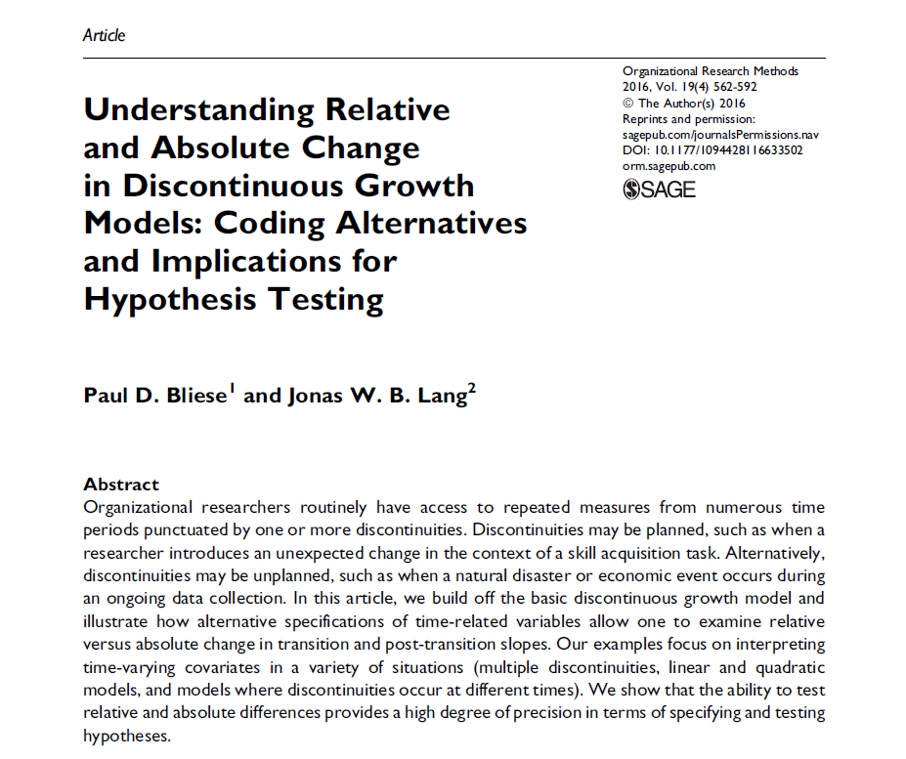
Discontinuous Growth Models
Coding Discontinuous Growth Models
TIME | EVENT | POST | Score
0 | 0 | 0 | X1
1 | 0 | 0 | X2
2 | 0 | 0 | X3
3 | 1 | 0 | X4
4 | 1 | 1 | X5
5 | 1 | 2 | X6
6 | 1 | 3 | x7
Event happened at this time!

Slide 28
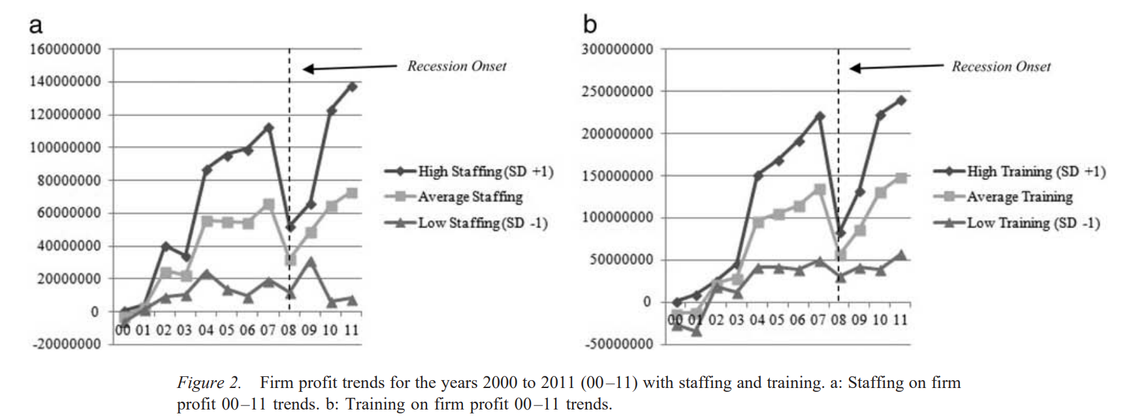
Discontinuous Growth Models – Examples
Firm Productivity during the Great Recession
Kim & Ployhart (2014)

Slide 29
Discontinuous Growth Models – Examples
Sleep
Bliese, McGurk, Thomas, Balkin & Wesensten (2007)

Slide 30
Discontinuous Growth Models – Examples
Sleep Banking
Rupp, Wesensten, Bliese & Balkin (2009)

Slide 31
Discontinuous Growth Models – Examples
Adaptability and Change in Performance
Lang & Bliese (2009)

Slide 32
Discontinuous Growth Models – Examples
State-Level GDP Change
>library(lattice)
>xyplot(GDP1k~Year|as.factor(State),
data = dat.GDP[dat.GDP$State %in% c("Wisconsin","Kentucky","Nevada", "Oregon","South Dakota","Colorado", "Iowa","Minnesota","Missouri"),],
layout = c(3,3),
type = c("p","g","r"), col="dark blue",
col.line = "black",
xlab = "Years",
ylab= "GDP (1k Mil)")

Slide 33
Discontinuous Growth Models – Examples
State-Level GDP Change
>plot(
x = c(1997:2023),
y = as.numeric(gsub("[^0-9]", "", summary(dat.GDP.W[,c(2:28)], na.rm=T)
[seq(from=4,to=162,by=6)]))/10000,
type = "o", col = "blue",
xlab = "Years", ylab = "Mean GDP (1k)",
main = "Average GDP growth (1997 to 2023)")

Slide 34
DGM – Interpreting the Models
Average GDP Growth (1997 to 2023)
Mean GDP (1k)
Years
2000
2005
2010
2015
2020

Slide 35
DGM – Interpreting the Models
Questions we can ask
1. What is the overall pattern (pre-transition slope, transition change, post-transition slope) over time?
2. Are there differences in overall levels of GDP (intercept)?
3. Do States differ on pre-transition slopes, transition change, post-transition slopes?
4. What State-level variables predict pre-transition slope, transition change, post-transition slope?
Average GDP Growth (1997 to 2023)
Mean GDP (1k)
Years
2000
2005
2010
2015
2020

Slide 36
Lets run through our example! (Random Coefficient DISCONTINUOUS Growth Model)

Slide 37
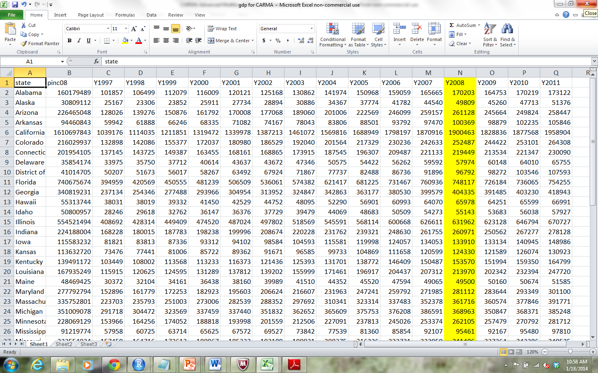
DGM – Importing the data
State-level GDP for 9 years (1997-2023)
In 2008, “Great Recession”

Slide 38
DGM – Importing the data
Read data into R:
Copy data in EXCEL (Ctrl-C) “SMA PDW – Yearly GDP Example 1.csv”
Paste into R with commands below
> dat.GDP.W <- read. delim(file="clipboard")
> names(dat.GDP.W)
[1] "state“ “GDP.1997“ "GDP.1998“ "GDP.1999“ "GDP.2000“ "GDP.2001“
[7] "GDP.2002“ "GD.P2003“ "GDP.2004“ "GDP.2005“ "GDP.2006“ "GDP.2007“
[13] "GDP.2008“ "GDP.2009“ "GDP.2010" "GDP.2011“ "GDP.2012“ "GDP.2013“
[19] "GDP.2014“ "GDP.2015“ "GDP.2016“ "GDP.2017“ "GDP.2018“ "GDP.2019“
[25] "GDP.2020“ "GDP.2021“ "GDP.2022“ "GDP.2023“ "GDP.2009“ "GDP.2010“
[31] "GDP.2011"
> #For MAC users
> Gdpdata <- read.table(pipe("pbpaste"),sep="\t",header=T)

Slide 39
DGM – Cleaning the Data
Check the variables and convert to univariate
> library(multilevel)
> dat.GDP <- make.univ(dat.GDP.W, dat.GDP.W[,2:28],outname=“GDP")
> dat.GDP[,c(1:5,18:19)]
state Y1997 Y1998 Y1999 … TIME GDP
1 Alabama 101857 106499 112079 … 0 101857
1.1 Alabama 101857 106499 112079 … 1 106499
1.2 Alabama 101857 106499 112079 … 2 112079
1.3 Alabama 101857 106499 112079 … 3 116009
1.4 Alabama 101857 106499 112079 … 4 120121
1.5 Alabama 101857 106499 112079 … 5 125168
1.6 Alabama 101857 106499 112079 … 6 130862
1.7 Alabama 101857 106499 112079 … 7 141974
. . . .
Should get something like this

Slide 40
DGM – Cleaning the Data
Make the DV more manageable by dividing by 1000
state TIME GDP
1 Alabama 0 101857
1.1 Alabama 1 106499
1.2 Alabama 2 112079
1.3 Alabama 3 116009
1.4 Alabama 4 120121
1.5 Alabama 5 125168
1.6 Alabama 6 130862
1.7 Alabama 7 141974
1.8 Alabama 8 150968
1.9 Alabama 9 159059
1.10 Alabama 10 165665
1.11 Alabama 11 170203
1.12 Alabama 12 164753
1.13 Alabama 13 170219
1.14 Alabama 14 173122
2 Alaska 0 25167
> dat.GDP$GDP1k <- dat.GDP$GDP/1000
> dat.GDP[1:10,
c("state","TIME",“GDP",“GDP1k")]
state TIME gdp gdp1k
1 Alabama 0 101857 101.857
1.1 Alabama 1 106499 106.499
1.2 Alabama 2 112079 112.079
1.3 Alabama 3 116009 116.009
1.4 Alabama 4 120121 120.121
1.5 Alabama 5 125168 125.168
1.6 Alabama 6 130862 130.862
1.7 Alabama 7 141974 141.974
1.8 Alabama 8 150968 150.968
1.9 Alabama 9 159059 159.059

Slide 41
DGM – Cleaning the Data
Only want to look at 4 years before and 4 years after the 2008 recession
> dat.GDP$Year <- dat.GDP$TIME + 1997
> dat1 <- dat.GDP[dat.GDP$Year >= 2004 & dat.GDP$Year <= 2012

Slide 42
DGM – Setting up the DGM Matrix
The basic linear growth model includes TIME
Additional TIME-based covariates potentially describe other forms of continuous change (e.g., quadratic)
> tmod <- lme(GDP1k~TIME,random=~1|State,dat1,control=list(opt="optim"))
> round(summary(tmod)$tTable,dig=3)
Value Std.Error DF t-value p-value
(Intercept) 283.248 54.514 407 5.196 0
TIME 3.665 0.409 407 8.965 0
> tmod <- lme(GDP1k~TIME+I(TIME^2),random=~1|State,dat1,control=list(opt="optim"))
> round(summary(tmod)$tTable,dig=3)
Value Std.Error DF t-value p-value
(Intercept) 253.964 58.277 406 4.358 0.000
TIME 9.299 3.985 406 2.334 0.020
I(TIME^2) -0.256 0.180 406 -1.421 0.156

Slide 43
Create Time-Related Covariates
Discontinuity is captured by adding additional TIME-based covariates
Break time into segments
The discontinuous growth model we consider uses three TIME-based covariates to capture
Pre-discontinuity slope (TIME)
Change at the transition (EVENT)
Post-discontinuity transition slope (POST)

Slide 44
DGM – Time Covariates
Average GDP Growth (2004 to 2012)
Mean GDP (1k)
POST
TIME
EVENT
Years
2004
2006
2008
2010
2012

Slide 45
Create Time-Related Covariates
The TIME-based covariate for the transition (EVENT) is a dummy-coded variable
Pre-transition coded as 0
Post-transition coded as 1
In our example, 2008 is the year of discontinuity
2004 to 2007 is pre-recession
2008 to 2012 is post-recession
The ifelse function in R can be used to efficiently create the EVENT variable
> # Fix TIME
> dat1$TIME <- dat1$TIME - 5
> dat1$EVENT <- ifelse(dat1$Year < 2008,0,1)

Slide 46
Create Time-Related Covariates
The TIME-based covariate for the recovery slope (POST) is a combination of dummy and continuous
Pre-transition coded as 0
Post-transition slope coded 0 to n-1 post transition observations
In our example
2004 to 2007 coded as 0
2008 to 2012 coded 0,1,2,3
R code subtracts 2008 from TIME for 2008-2012, and a 0 elsewhere
> da1$POST <- ifelse(dat1$YEAR < 2008,0,dat1$Year-2008)

Slide 47
Create Time-Related Covariates
> dat1[1:9,c(“YEAR","TIME",“EVENT",“POST")]
YEAR TIME EVENT POST
1.7 2004 0 0 0
1.8 2005 1 0 0
1.9 2006 2 0 0
1.10 2007 3 0 0
1.11 2008 4 1 0
1.12 2009 5 1 1
1.13 2010 6 1 2
1.14 2011 7 1 3
1.15 2012 8 1 4

Slide 48
Model Building Steps
Notes on optimization in lme function
Build Level-1 Model (Bliese & Ployhart, 2002)
Step 1: Estimate the ICC
Step 2: Examine Fixed Effects for:
TIME
TRANS
RECOV
Step 3: Examine Variability in Growth Parameters
Step 4: Model autocorrelation
Step 5: Contrast Alternative Models
Build Level-2 Model (step 6)
Add level-2 predictors (Level-2)

Slide 49
Optimization
The lme function uses two different routines in the stats package for optimization
The function optim
The function nlmimb
The default after versions 2.2 of R has been nlmimb
Very precise
Less robust than optim
Complex models sometimes fail to converge, so we set the “control” parameter
> csetting.basic <- lmeControl(opt="optim")
> csetting.advanced <- lmeControl(maxIter=3000,msMaxIter=3000,opt=“optim”,optimMethod=“Nelder-Mead”)
> My.Model <- lme(DV~IV, random=~IV|GRP,data=MYDATA,control=csetting.basic)

Slide 50
Step 0: ICC estimate
ICC values are important to estimate
In this example, the ICC value is extremely high (0.996) working against finding discontinuous effects
Large differences across States
Low within-State variability
> mod0 <- lme(GDP1k~1,random=~1|State,dat1,control=csetting.basic)
> gmeanrel(mod0)$ICC
[1] 0.9959573
> VarCorr(mod0)
State = pdLogChol(1)
Variance StdDev
(Intercept) 150462.4560 387.89490
Residual 610.7407 24.71317
> 150462.4560 /(150462.4560 + 610.7407)
[1] 0.9959573

Slide 51
Step 1: Basic OLS
Create a basic model to compare
> mod1 <- gls(GDP1k~TIME+EVENT+POST, data=dat1)
> round(summary(mod1)$tTable,dig=2)
Value Std.Error t-value p-value
(Intercept) 303.07 45.27 6.69 0.00
TIME 8.54 24.20 0.35 0.72
EVENT -15.35 78.41 -.20 0.84
POST -4.64 29.64 -.16 0.88

Slide 52
Step 2: Check for Random Intercepts
Create an RCM to assess random intercepts
Since the -2LL = 2200.564 (p < .01), we conclude that a model that accounts for random intercepts is useful
> mod2 <- lme(GDP1k~TIME+EVENT+POST, random=~1|State, data=dat1, control=csetting.basic)
> anova(mod1,mod2)
Model df AIC BIC logLik Test L.Ratio p-value
mod1 1 5 6744.644 6765.266 -3367.332
mod2 2 6 4546.100 4570.822 -2267.050 1 vs 2 2200.564 <.0001

Slide 53
Step 2: Check for Random Intercepts
Notes:
library(lattice)
xyplot(gdp1k~I(TIME+1997)|as.factor(Area),
data=gdp.univ[1:240,],
layout = c(4,4),
type=c("p","g"),cex=1.2,pch=20,
col="black",
xlab=list("YEAR",cex=1.5),
ylab=list("GDP / 100K",cex=1.5))

Slide 54
Step 2: Check for Random Intercepts
In 2004 (TIME 0), the average level of GDP across the 51 States was $303,000 M (303.07*1000)
GDP increased by $8,540M each year
GDP dropped by $15,350M in 2008 (relative to expected increase)
After the 2008 recession, GDP grew at a rate $4,640M LOWER than pre-recession levels (GDP growth was weaker, but still positive! Post-Recession Growth = $3,940M per year)
> mod2 <- lme(GDP1k~TIME+EVENT+POST, random=~1|State, data=dat1, control=csetting.basic)
> round(summary(mod2)$tTable,dig=2)
Value Std.Error DF t-value p-value
(Intercept) 303.07 54.38 405 5.57 0.00
TIME 8.54 1.40 405 6.12 0.00
EVENT -15.35 4.52 405 -3.39 0.00
POST -4.64 1.71 405 -2.71 0.01

Slide 55
DGM – Time Covariates
Average GDP Growth (2004 to 2012)
Mean GDP (1k)
Post-Recession slope $4,640M
Less than original slope
POST
GDP at Time 0
equals $303,070M
TIME
EVENT
Drop of $15,350M
$8,540M yearly increase
Years
2004
2006
2008
2010
2012

Slide 56
Step 3: Check for Random Slopes
Examine potential variability in time-based parameters
Add random slopes one at a time and contrast models
Best fit for model with random slopes for TIME, EVENT and POST
Suggests significant variability in all Time related parameters across States
> mod3a <- update(mod2,random=~TIME|State)
> mod3b <- update(mod2,random=~TIME+EVENT|State)
> mod3c <- update(mod2,random=~TIME+EVENT+POST|State)
> anova(mod2,mod3.a,mod3.b,mod3.c)
Model df AIC BIC logLik Test L.Ratio p-value
mod2 1 6 4546.100 4570.822 -2267.050
mod3a 2 8 4097.494 4130.456 -2040.747 1 vs 2 452.6060 <.0001
mod3b 3 11 4049.445 4094.768 -2013.722 2 vs 3 54.0494 <.0001
mod3c 4 15 3959.560 4021.364 -1964.780 3 vs 4 97.8849 <.0001

Slide 57
Step 3: Modeling State Variability
Contrast models with fixed slopes vs random slopes
Both models convey that parameters are variable
one through large SE’s
one showing significant variability among States
> round(summary(mod2)$tTable,dig=2)
Value Std.Error DF t-value p-value
(Intercept) 303.07 54.38 405 5.57 0.00
TIME 8.54 1.40 405 6.12 0.00
EVENT -15.35 4.52 405 -3.39 0.00
POST -4.64 1.71 405 -2.71 0.01
> round(summary(mod3c)$tTable,dig=2)
Value Std.Error DF t-value p-value
(Intercept) 303.07 50.10 405 6.05 0
TIME 8.54 1.91 405 4.46 0
EVENT -15.35 3.45 405 -4.44 0
POST -4.64 1.37 405 -3.39 0

Slide 58
Step 4: Testing for Autocorrelation
Up to now, models assume independent errors in the covariance structure of the data.
No pattern to level-1 model residuals
Assumption of independent errors is rarely supported when dealing with repeated measures over time.
As Littell, Milliken, Stroup, and Wolfinger (1996) note:
“measurements taken at adjacent times are typically more highly
correlated than two measurements taken several time points apart”
(p. 88).

Slide 59
Step 4: Testing for Autocorrelation
The correlation option in lme specifies alternative within-group correlation structures.
A common structure is corAR1() or first-order autoregressive
Update mod3c and contrasting the -2 log likelihood values between the two models
Notice 1 df difference for the estimate of phi in mod4
> mod4a <- update(mod3c,correlation=corAR1(form=~TIME|State))
> anova(mod3c,mod4a)
Model df AIC BIC logLik Test L.Ratio p-value
mod3c 1 15 3959.560 4021.364 -1964.780
mod4a 2 16 3919.512 3985.437 -1943.756 1 vs 2 42.04733 <.0001

Slide 60
Step 4: Testing for Autocorrelation
> summary(mod4a)
Linear mixed-effects model fit by REML
Data: dat1
AIC BIC logLik
3919.512 3985.437 -1943.756
Random effects:
Formula: ~TIME + EVENT + POST | State
Structure: General positive-definite, Log-Cholesky parametrization
StdDev Corr
(Intercept) 358.213257 (Intr) TIME EVENT
TIME 12.287298 0.966
EVENT 13.007387 -0.972 -0.973
POST 6.683782 -0.969 -0.923 0.909
Residual 19.407462
Correlation Structure: AR(1)
Formula: ~1 | State
Parameter estimate(s):
Phi
0.8368064

Slide 61
Step 4: Testing for Autocorrelation
Contrast models with and without adjustment of lag-1 autocorrelation
Changes in both parameter estimates and SEs
> round(summary(mod3c)$tTable,dig=2)
Value Std.Error DF t-value p-value
(Intercept) 303.07 50.10 405 6.05 0
TIME 8.54 1.91 405 4.46 0
EVENT -15.35 3.45 405 -4.44 0
POST -4.64 1.37 405 -3.39 0
> round(summary(mod4a)$tTable,dig=2)
Value Std.Error DF t-value p-value
(Intercept) 301.58 50.23 405 6.00 0
TIME 8.35 1.91 405 4.38 0
EVENT -8.43 2.60 405 -3.25 0
POST -5.17 1.50 405 -3.46 0

Slide 62
Step 4: Testing for Autocorrelation
We can also check the heteroscedasticity using the weights option in lme
Results indicate that accounting for heteroscedasticity improves the model.
> mod4b <- update(mod4a, weights=varExp(form=~TIME))
> anova(mod4a, mod4b)
Model df AIC BIC logLik Test L.Ratio p-value
mod4a 1 16 3919.512 3985.437 -1943.756
mod4b 2 17 3908.058 3978.103 -1937.029 1 vs 2 13.45442 2e-04
> round(summary(mod4b)$tTable,dig=2)
Value Std.Error DF t-value p-value
(Intercept) 302.04 50.11 405 6.03 0
TIME 8.75 1.89 405 4.64 0
EVENT -8.56 2.45 405 -3.49 0
POST -6.58 1.68 405 -3.92 0

Slide 63
Step 4: Results
Average GDP Growth (2004 to 2012)
Post-Recession slope $6,580M
Less than original slope
Mean GDP (1k)
Drop of $8,560M from where it
would be expected in 2008
GDP at Time 0
equals $302,040M
$8,750M yearly increase
Years
2004
2006
2008
2010
2012

Slide 64
Step 5: Contrasting Alternative Models
The parameters TIME, EVENT and POST represent a flexible discontinuous model
In some cases, however, discontinuity might be captured with two of the three parameters
TIME and EVENT
TIME and POST
The form of the discontinuity differs depending upon which parameters are included

Slide 65
Step 5: Contrasting Alternative Models
The model with TIME and EVENT has identical slopes pre- and post-discontinuity:
> mod5a <- lme(GDP1k~TIME+EVENT, random=~TIME+EVENT|State, dat1, correlation=corAR1(form=~TIME|State), weights=varExp(form=~TIME), control=csetting.advanced)
> round(summary(mod5a)$tTable,2)
Value Std.Error DF t-value p-value
(Intercept) 302.50 51.57 406 5.90 0.00
TIME 5.47 1.30 406 4.15 0.00
EVENT -5.27 2.78 406 -2.05 0.04

Slide 66
Step 4: Results
Average GDP Growth (2004 to 2012)
Drop of $5,270M
From where we would expect
Mean GDP (1k)
Slopes are equal
Years
2004
2006
2008
2010
2012

Slide 67
Step 4: Results
Average GDP Growth (2004 to 2012)
Mean GDP (1k)
TIME and EVENT
TIME, EVENT, POST
Years
2004
2006
2008
2010
2012

Slide 68
Step 5: Contrasting Alternative Models
The model with TIME and RECOV has a change in slope pre and post-discontinuity
Excludes a parameter for a drop or increase at a specific time (2008):
> mod5b <- lme(GDP1k ~ TIME + POST, random = ~TIME + POST|State, dat1, correlation=corAR1(form=~TIME+POST|State), weights=varExp(form=~TIME), control=csetting.advanced)
> round(summary(mod5b)$tTable,2)
Value Std.Error DF t-value p-value
(Intercept) 301.38 49.96 406 6.03 0.00
TIME 5.87 1.31 406 4.48 0.00
POST -2.04 1.14 406 -1.79 0.07

Slide 69
Step 4: Results
Average GDP Growth (2004 to 2012)
No Drop
Mean GDP (1k)
Slopes are unequal
Years
2004
2006
2008
2010
2012

Slide 70
Step 4: Results
Average GDP Growth (2004 to 2012)
Mean GDP (1k)
TIME and POST
TIME, EVENT, POST
Years
2004
2006
2008
2010
2012

Slide 71
Step 5: Picking Alternative Models
Alternative models have different predictors so comparisons of -2 log likelihood values is not appropriate
Default is Restricted-Maximum Likelihood (REML)
With REML, -2 log likelihood contrasts should be used only on random effects
May be useful to examine:
Akaike’s Information Criterion (AIC)
Bayesian Information Criterion (BIC)
Smaller is better
Can contrast values across non-nested models

Slide 72
Step 5: Picking Alternative Models
Akaike’s Information Criterion (AIC)
Formula: 2k – (2 * (logLik))
Bayesian Information Criterion (BIC)
Formula (large n approx): -2 * logLik + k * log(n)
The BIC carries more of a penalty for additional parameters (k) than does the AIC
Practically speaking, this means that the BIC will favor simpler models
> logLik(mod5a)
'log Lik.' -1981.613 (df=12)
> AIC(mod5a)
[1] 3987.226
> BIC(mod5a)
[1] 4036.696
> logLik(mod5b)
'log Lik.' -1963.929 (df=12)
> AIC(mod5b)
[1] 3951.857
> BIC(mod5b)
[1] 4001.327

Slide 73
Step 5: Picking Alternative Models
Models:
Three parameter model (mod4b)
TIME + EVENT (mod5a)
TIME + POST(mod5b)
Three parameter model (mod4) is best choice:
Lowest AIC
Lowest BIC
> AIC(mod4b)
[1] 3908.058
> BIC(mod4b)
[1] 3978.103
> AIC(mod5a)
[1] 3987.226
> BIC(mod5a)
[1] 4036.696
> AIC(mod5b)
[1] 3951.857
> BIC(mod5b)
[1] 4001.327

Slide 74
Step 6: Adding Level-2 Predictors
The final step in discontinuous growth modeling is to add level-2 predictors of all the parameters found to randomly vary
In the GDP example, there are State-level differences in:
Intercepts (e.g., mean levels of GDP)
Pre-transition slope (TIME)
Change at the transition point (EVENT)
Post-transition slope (POST)

Slide 75
Step 6: Adding Level-2 Predictors
Read data into R:
Copy data in EXCEL (Ctrl-C) “SMA PDW – Yearly GDP Example 2.csv”
Paste into R with commands below
> dat.GDP2.W <- read. delim(file="clipboard")
> library(multilevel)
dat.GDP2 <- mult.make.univ(dat.GDP2.Wdvlist=list(
GDP=c("GDP.1997","GDP.1998","GDP.1999","GDP.2000","GDP.2001","GDP.2002","GDP.2003","GDP.2004",
"GDP.2005","GDP.2006","GDP.2007","GDP.2008","GDP.2009","GDP.2010","GDP.2011","GDP.2012",
"GDP.2013","GDP.2014","GDP.2015","GDP.2016","GDP.2017","GDP.2018","GDP.2019","GDP.2020",
"GDP.2021","GDP.2022","GDP.2023"),
Tax =c("Tax.1997","Tax.1998","Tax.1999","Tax.2000","Tax.2001","Tax.2002","Tax.2003","Tax.2004",
"Tax.2005","Tax.2006","Tax.2007","Tax.2008","Tax.2009","Tax.2010","Tax.2011","Tax.2012",
"Tax.2013","Tax.2014","Tax.2015","Tax.2016","Tax.2017","Tax.2018","Tax.2019","Tax.2020",
"Tax.2021","Tax.2022","Tax.2023")
))[,c("State","TIME","GDP","Tax","Pop.2010")]

Slide 76
Step 6: Adding Level-2 Predictors
Clean the data
> dat.GDP2$GDP1k <- dat.GDP2$GDP / 1000
> dat.GDP2$Tax1k <- dat.GDP2$Tax / 1000
> dat.GDP2$Pop.GM <- (dat.GDP2$Pop.2010/100000) - mean(dat.GDP2$Pop.2010/100000)
> dat.GDP2$Year <- dat.GDP2$TIME + 1997
> dat2 <- dat.GDP2[dat.GDP2$Year >= 2004 & dat.GDP2$Year <= 2012
> dat2$TIME <- dat2$TIME - 7
> dat2$TIME.A <- ifelse(dat2$Year < 2008, dat2$TIME, 3)
> dat2$EVENT <- ifelse(dat2$Year < 2008, 0, 1)
> dat2$POST <- ifelse(dat2$Year < 2008, 0, dat2$Year – 2008)

Slide 77
Step 6: Modeling State Variability
Predicting Intercept Variability
State-Level Average Population
> mod.Pop <- lme(GDP1k ~ TIME + EVENT + POST + Pop.GM
+ ,random = ~TIME + EVENT + POST|State
+ ,correlation=corAR1()
+ ,weights=varExp(form=~TIME)
+ ,data = dat2
+ ,control = csetting.advanced)
> round(summary(mod.Pop)$tTable, dig=2)
Value Std.Error DF t-value p-value
(Intercept) 301.95 8.95 405 33.75 0
TIME 8.57 1.86 405 4.60 0
EVENT -8.67 2.39 405 -3.63 0
POST -6.09 1.57 405 -3.87 0
Pop.GM 5.41 0.12 49 45.06 0

Slide 78
Step 6: Modeling State Variability
Notice huge change in Intercept Variance
> VarCorr(mod4b)
State = pdLogChol(TIME + EVENT + POST)
Variance StdDev Corr
(Intercept) 127808.38818 357.502990 (Intr) TIME EVENT
TIME 156.41191 12.506475 0.974
EVENT 165.20054 12.853036 -0.988 -0.954
POST 75.26766 8.675694 -0.938 -0.953 0.897
Residual 273.38012 16.534210
> VarCorr(mod.Pop)
State = pdLogChol(TIME + EVENT + POST)
Variance StdDev Corr
(Intercept) 3913.30616 62.556424 (Intr) TIME EVENT
TIME 153.38017 12.384675 -0.303
EVENT 141.37025 11.889922 0.428 -0.960
POST 63.32903 7.957954 0.558 -0.945 0.956
Residual 168.26107 12.971548

Slide 79
Step 6: Modeling Variability in Time-Based Parameters
Personal Income and State-Level variability in:
Pre-discontinuity slope (TIME)
Discontinuity (TRANS)
Post-discontinuity slope (RECOV)
Maryland
Tennessee
Colorado
Mean GDP (1k)
2004
2006
2008
2010
2012
Years

Slide 80
Step 6: Modeling Variability in Time-Based Parameters
> mod.Pop <- lme(GDP1k ~ TIME + EVENT + POST + Pop.GM
+ + TIME*Pop.GM
+ + EVENT*Pop.GM
+ + POST*Pop.GM
+ ,random = ~TIME + EVENT + POST|State
+ ,correlation=corAR1()
+ ,data = dat2
+ ,control = csetting.basic)
> round(summary(mod.Pop)$tTable, dig=2)
Value Std.Error DF t-value p-value
(Intercept) 301.56 8.76 402 34.43 0
TIME 8.39 0.90 402 9.33 0
EVENT -8.38 1.83 402 -4.57 0
POST -5.22 1.27 402 -4.10 0
Pop.GM 5.14 0.13 49 39.67 0
TIME:Pop.GM 0.18 0.01 402 13.26 0
EVENT:Pop.GM -0.19 0.03 402 -6.89 0
POST:Pop.GM -0.10 0.02 402 -5.51 0

Slide 81
Step 6: Modeling Variability in Time-Based Parameters

Slide 82
Some Extensions
Other models
Bliese & Lang (2016) – Absolute Variant
> round(summary(mod.absolute)$tTable,dig=2)
Value Std.Error DF t-value p-value
(Intercept) 302.06 50.34 405 6.00 0.00
TIME 9.37 1.94 405 4.82 0.00
EVENT -.26 1.74 405 -0.15 0.88
POST 2.90 1.19 405 2.45 0.01
Mean GDP (1k)
2004
2006
2008
2010
2012
Years

Slide 83
Some Extensions
Other models
Bliese & Lang (2016) – Multiple Discontinuities

Slide 84
Some Extensions
YEAR TIME EVENT1 POST1 EVENT2 POST2
…
2004 0 0 0 0 0
2005 1 0 0 0 0
2006 2 0 0 0 0
2007 3 0 0 0 0
2008 4 1 0 0 0
2009 5 1 1 0 0
2010 6 1 2 0 0
2011 7 1 3 0 0
2012 8 1 4 0 0
2013 9 1 5 0 0
2014 10 1 6 0 0
2015 11 1 7 0 0
2016 12 1 8 0 0
2017 13 1 9 0 0
2018 14 1 10 0 0
2019 15 1 11 0 0
2020 16 1 12 1 0
2021 17 1 13 1 0
2022 18 1 14 1 1
2023 19 1 15 1 2
Other models
Bliese & Lang (2016) – Multiple Discontinuities

Slide 85
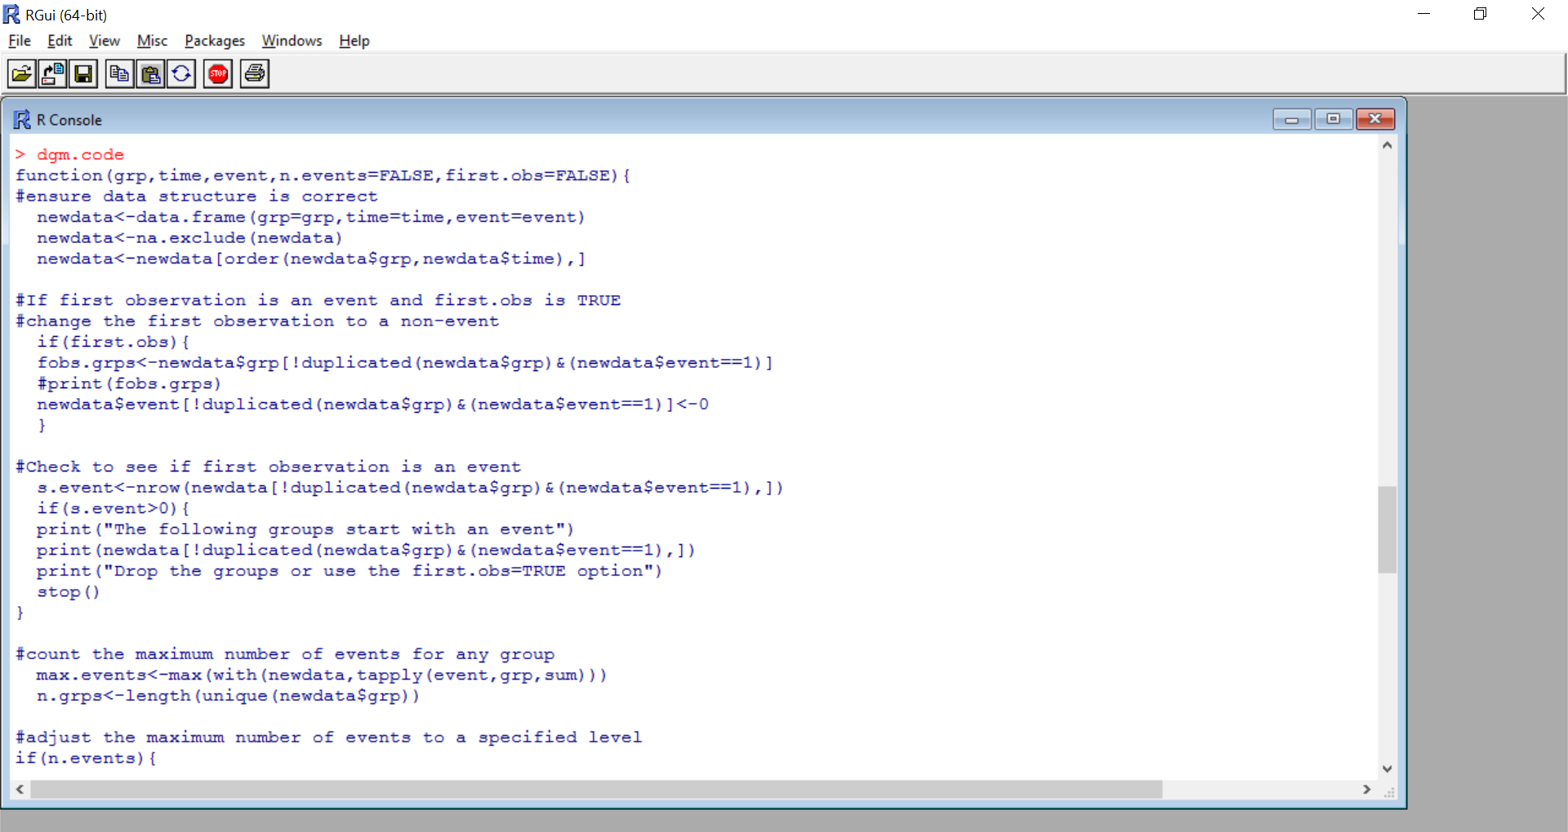
Some Extensions
Automating the process (dgm.code in multilevel library)

Slide 86
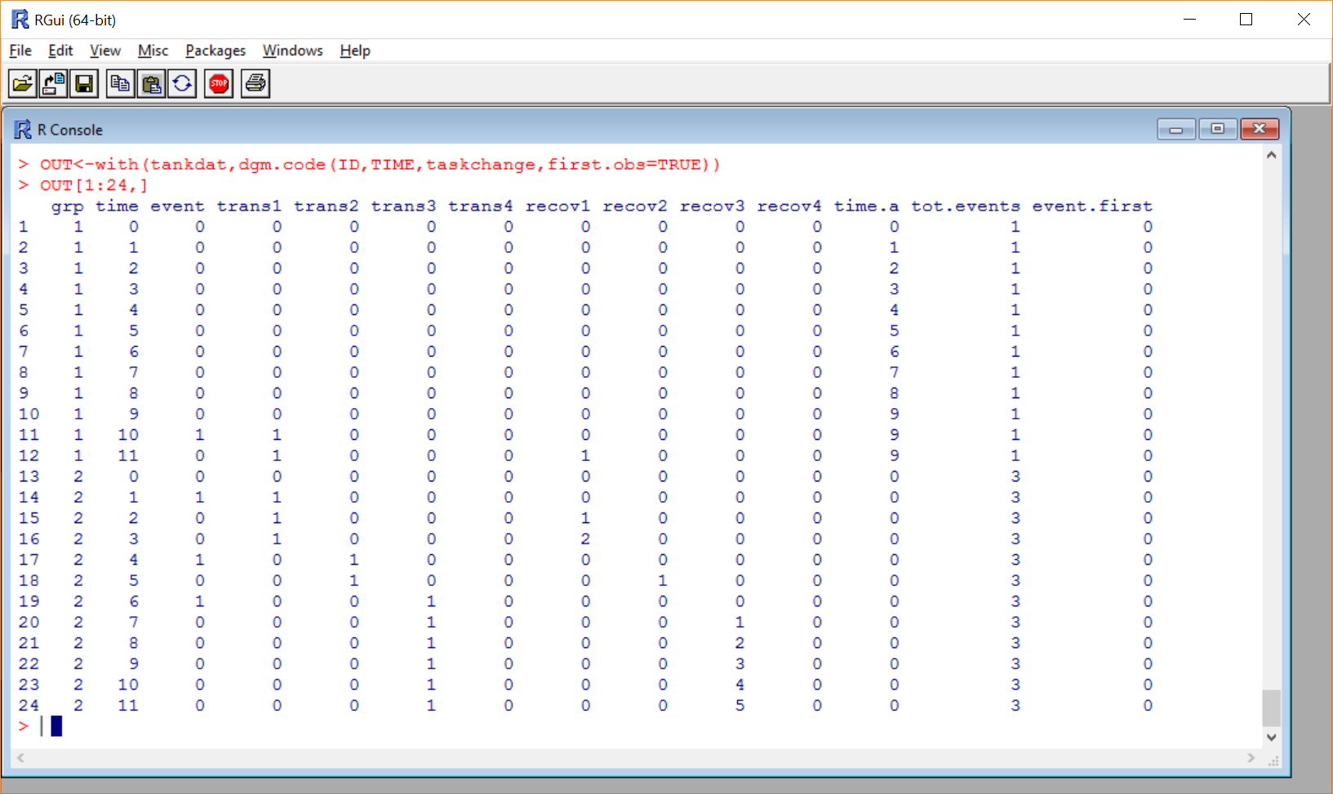
Some Extensions
Automating the process (dgm.code)

Slide 87
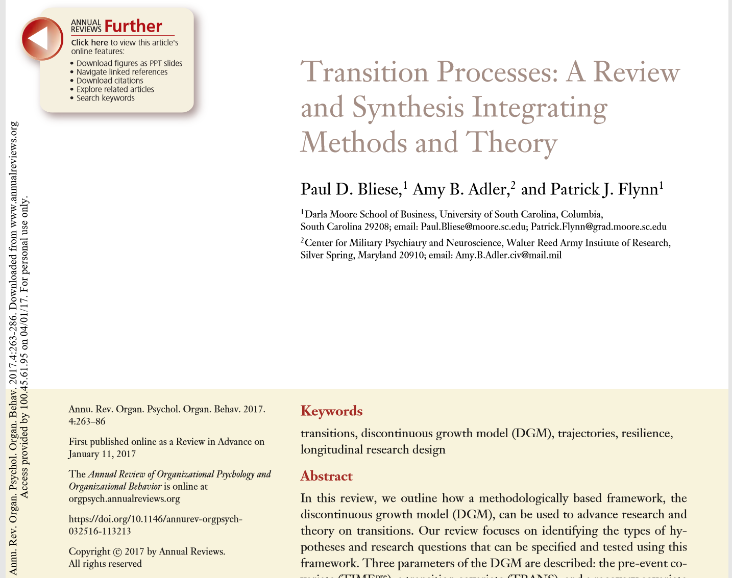
Some Extensions
Integrating methods and theory
Annual Review of Organizational Psychology and Organizational Behavior

Slide 88
Emergence Models
Basic Question
“Do group members’ feelings and perceptions become more similar or less similar over time?”
Proposed Method to:
Formally test and quantify whether consensus in groups emerges over a period in time
Understand how group member characteristics (e.g., being in a leadership role) relate to emergent tendencies within groups (Cronin & Weingart, 2011; Humphrey & Aime, 2014; Morgeson & Hofmann, 1999)
Study how unit-characteristics (e.g., baseline collective efficacy) predict consensus emergence over time.

Slide 89
Example 1
ICC(1) values of .03, .00, .25, .40, and .58 (Time 1-Time 5)
Time

Slide 90
Example 2
ICC(1) values of .01, .00, .19, .54, and .72 (Time 1-Time 5)

Slide 91

Growth Models and Variants
Lang, J. W. B., Bliese, P. D., & de Voogt, A. (2018)
Parameters | M2a | M2b
Army data, DV = Job satisfaction
Intercept, γ₀₀₀ | 3.26 | 3.26
TIME, γ₁₀₀ | 0.05 | 0.05
Group intercept variance, σ_{β00}² | 0.11 | 0.10
Group variance for TIME, σ_{β10}² | 0.01 | 0.01
Covariance, σ_{β00β10} | -0.03 | -0.02
Person intercept variance, σ_{π0}² | 0.38 | 0.38
Residual variance, σ_{e}² | 0.43 | 0.51
TIME, δ₁ |  | -0.10

Slide 92
DGM Modeling Step Summary (part 1)
Model Steps | What to Interpret
BUILD THE LEVEL 1 MODEL
Step 0 – Estimate the ICC | Interclass Correlation Estimates
Step 1 – Run OLS
Step 2 – Determine the Fixed Effects for Time | Significance of TIME Parameters
(a) Linear-only Model
(b) Quadratic Model
Step 3 – Determine Variability in Growth Parameters | -2Log-Likelihood Ratio Tests
(a) TIME
(b) TIME+EVENT
(c) TIME+EVENT+POST
Step 4 – Determine the Error Structure | -2Log-Likelihood Ratio Tests
(a) Errors Correlated (autoregressive)
(b) Errors Correlated and Heterogenous

Slide 93
DGM Modeling Step Summary (part 2)
Model Steps | What to Interpret
BUILD THE LEVEL 2 MODEL
Step 5 – Between- or Within-Entity Predictors of Intercept and Slope Variability in Order of Theoretical Importance | Significance Tests of Parameters

Slide 94
Q&A Time!

